Slide 1
Optimizing Apache Spark:
The Five Most Common Performance
Problems - Condensed

Slide 2
The 5 Most Common Performance Problems (The 5 Ss)
Five Basic Problems
The most egregious problems fall into one of five categories:
Spill: The writing of temp files to disk due to a lack of memory
Skew: An imbalance in the size of partitions
Shuffle: The act of moving data between executors
Storage: A set of problems directly related to how data is stored on disk
Serialization: The distribution of code segments across the cluster

Slide 3
The 5 Most Common Performance Problems (The 5 Ss)
Five Basic Problems - Why it’s hard
Root sourcing problems is hard when one problem can causes another
Skew can induce Spill
Storage issues can induce excess Shuffle
Incorrectly addressing Shuffle can exacerbate Skew
Many of these problems can be present at the same time

Slide 4
The 5 Most Common Performance Problems (The 5 Ss)
The Spark UI
Before we can get started, we need to establish a baseline
We need to define terminology
We need to know how to navigate the Spark UI
We need to know how to interpret the Spark UI
Introducing the Spark UI Simulator
https://www.databricks.training/spark-ui-simulator

Slide 5
The 5 Most Common Performance Problems (The 5 Ss)
Quick Note on Benchmarking
There are generally three common approaches to benchmarking:
The count() action
The foreach() action with a do-nothing lambda
A noop (or no operation) write
Count operations are optimized and report significantly shorter times
For-Each operations induce serialization overhead which skews benchmarks
No-Op writes limit execute to ingestion, excludes writes & processes everything
Experiment #5980 illustrates how these strategies can very
Notes:
If the Introduction to the Spark UI did not precede this course, now is the time to introduce the simulator

Slide 6
Optimizing Apache Spark
The Five Most Common Performance
Problems - Condensed
Storage

Slide 7


If you had only 60 seconds to pick up as many coins as you can, one coin at a time, which pile do you want to work from?
$0.01 vs $0.25
$0.02 vs $0.50
$0.03 vs $0.75
$0.04 vs $1.00
$0.05 vs $1.25
$0.06 vs $1.50
$0.07 vs $1.75
$0.08 vs $2.00
$0.09 vs $2.25
$0.10 vs $2.50
$0.11 vs $2.75
$0.12 vs $3.00
$0.13 vs $3.25
$0.00

Slide 8
The 5 Most Common Performance Problems (The 5 Ss)
Storage - Examples #1
Tiny Files
See Experiment #8923
Step B with 41 million records clocks in at ~ 3 minutes
Step C with 2.7 billion records clocks in at ~10 minutes
Step D with 34 million record clocks in at ~1.5 hours

Slide 9
The 5 Most Common Performance Problems (The 5 Ss)
Storage - Examples #2
Scanning
See Experiment #8973, contrast Step B, Step C and Step D
Step B: 1 directory, 345K files clocks in at ~1 minute
Step C: 12 directories, 6K files clocks in at ~5 seconds
Step D: 8K directories, 6k files clocks in at ~14 minutes

Slide 10
The 5 Most Common Performance Problems (The 5 Ss)
Storage - Example #3
Inferring Schemas & Merging Schemas
Inferring schemas for JSON & CSV requires a full read of 100% of the data even when filtered - SLOWEST
For Parquet the schema is read from a single part file - FAST
For Parquet w/Schema Merging requires a read of the schema from all part-files - SLOW
For Delta the schema is read from the transaction log - FASTER
For tables, the schema is read from the meta store - FASTEST

Slide 11
The 5 Most Common Performance Problems (The 5 Ss)
Storage - Example #4
NVMe & SSD are up to 10x faster than Magnetic Drives
Does not apply to traditional data reads - those come from cloud storage
Applies to cluster-local disk operations like reading and writing shuffle files and Delta/Parquet IO Cache
See Experiment #5136A for HDD: clocks in at ~1.5 hours (SWT == 3 & 4.5 hr)
See Experiment #5136B for SSD: clocks in at ~1 hour (SWT == 2.5 & 1.5 hours)
See Experiment #5136C for NVMe: clocks in at ~45 minutes (SWT == 0 min)
SW* = Spill Write Time found in the Query Details

Slide 12
The 5 Most Common Performance Problems (The 5 Ss)
Mitigating Storage Issues
Use Delta + Unity Catalog - Delta provides it’s own optimizations and reading table schema from the catalog always outperforms reading from disk
Use NVMe & SSD for faster disk IO - further helps to mitigate shuffle
Employ AQE and spark.sql.adaptive.coalescePartitions.enabled to control your spark-partitions to minimize the production of tiny files
Employ spark.databricks.adaptive.autoOptimizeShuffle.enabled

Slide 13
The 5 Most Common Performance Problems (The 5 Ss)
Mitigating Storage Issues, Cont’
Use Delta’s OPTIMIZE operation to compact tiny files
Consider enabling Delta’s Auto Compaction and Optimized Writes
Consider employing Databricks’ Auto Loader

Slide 14
Optimizing Apache Spark
The Five Most Common Performance
Problems - Condensed
Serialization

Slide 15
The 5 Most Common Performance Problems (The 5 Ss)
Serialization - Why it’s bad
Spark SQL and DataFrame instructions are highly optimized
All UDFs must be serialized and distributed to each executor
The parameters and return value of each UDF must be converted for each row of data
Python UDFs takes an even hard hit
The Python code has to be pickled
Spark must instantiate a Python interpreter in each and every Executor
The conversion of each row from Python to DataFrame costs even more

Slide 16
The 5 Most Common Performance Problems (The 5 Ss)
Serialization - UDFs vs Catalyst Optimizer
In addition to that…
UDFs create an analysis barrier for the Catalyst Optimizer
The Catalyst Optimizer cannot connect code before and after UDF
The UDF is a black box which means optimizations are limited to the code before and after, excluding the UDF and how all the code works together
?
010001111010100010101010010
010001111010100010101010010

Slide 17
The 5 Most Common Performance Problems (The 5 Ss)
Serialization - How Bad Is It?
See Experiment #4538 for Scala
Step D uses higher-order functions & clocks in at ~23 minutes (same as Python)
Step E uses Scala UDFs & clocks in at ~36 minutes
Step F uses Scala’s Typed Transformations & clocks in at ~26 minutes
See Experiment #4538 for Python
Step D uses higher-order functions & clocks in at ~23 minutes (same as Scala)
Step E uses Python UDFs & clocks in at ~1 hour & 45 minutes
Step F uses Python and Vectorized UDFS & clocks in at ~1 hour & 20 minutes

Slide 18
The 5 Most Common Performance Problems (The 5 Ss)
Mitigating Serialization Issues
Don’t use UDFs I challenge you to find a set of transformations that cannot be done with the built-in, continuously optimized, community supported, higher-order functions
If you have to use UDFs in Python (common for Data Scientist) use the Vectorized UDFs as opposed to the stock Python UDFs
If you have to use UDFs in Scala use Typed Transformations as opposed to the stock Scala UDFs
Resist the temptation to use UDFs to integrate Spark code with existing business logic - porting that logic to Spark almost always pays off

Slide 19
Optimizing Apache Spark
The Five Most Common Performance
Problems - Condensed
Skew

Slide 20
The 5 Most Common Performance Problems (The 5 Ss)
Skew
Data is typically read in as 128 MB partitions and evenly distributed
As the data is transformed (e.g. aggregated), it’s possible to have significantly more records in one Spark-partition than another
A small amount of skew is ignorable
But large skews can result in spill or worse, hard to diagnose OOM Errors

Slide 21
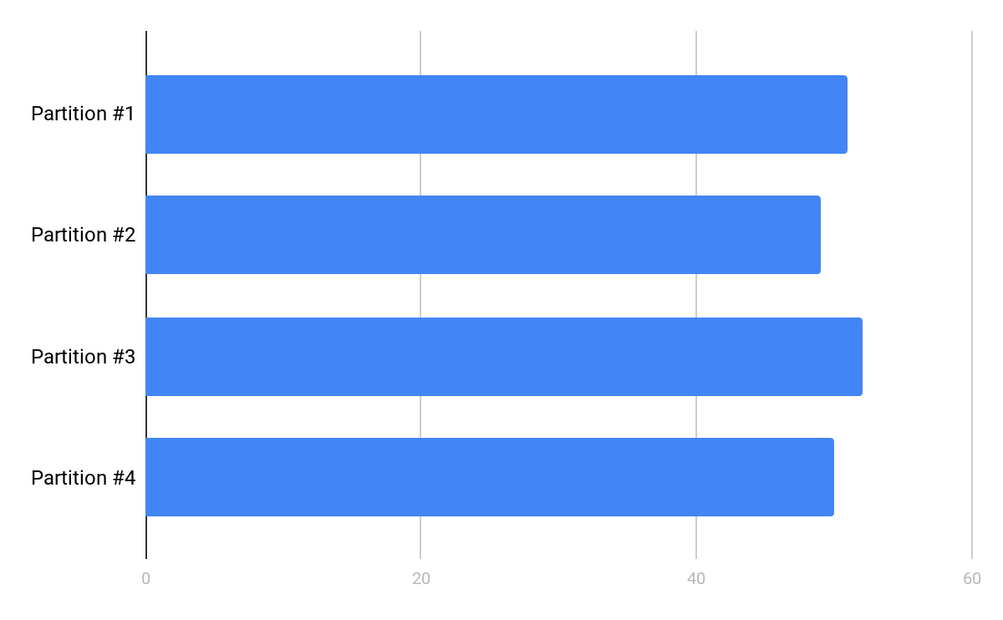
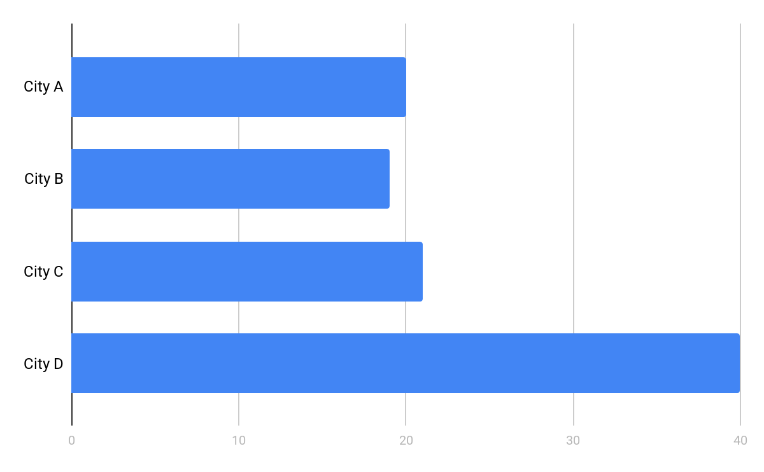
The 5 Most Common Performance Problems (The 5 Ss)
Skew - Before & After
Before aggregation After aggregation by city
Notes:
In this example, we have 4 partitions
They should be evenly distributed after the initial ingest by Spark.
City A, B, and C might be similar IF the data is correlated around something like population. The assumption here is that cities A, B and C are the same size.
But city D has twice the population, thus twice as many records
Who knows what cities E-ZZZ might look like - it doesn't matter for this illustration.

Slide 22
The 5 Most Common Performance Problems (The 5 Ss)
Skew - Ramifications
After aggregation by city
If City D is 2x larger than A, B or C…
It takes 2x as long to process
It requires 2x as much RAM
The ramifications of that is...
The entire stage will take as long as the longest running task
We may not have enough RAM for these skewed partitions
Notes:
Once aggregated around the city, we can expect that the partition containing D will be proportionally larger than our other three cities.
A larger partition means it has more records. More records means it will take Spark longer to process that partition.
In our example here, it can take Spark twice as long to process City D as it would take to process A, B or C.

Slide 23
The 5 Most Common Performance Problems (The 5 Ss)
Skew - Mitigation
There are three “common” solutions:
Salt the join keys forcing even distribution during the shuffle
This is the most complicated solution to implement
e.g. “normal” partitions might become too small if not properly adjusted
Can sometimes take longer to execute than other solutions
Databricks’ [proprietary] Skew Hint
Easier to add a single hint than to salt your keys
Great option for version of Spark 2.x
Adaptive Skew Join (enabled by default in Spark 3.1)
Outperforms the other two options and is enabled by default!

Slide 24
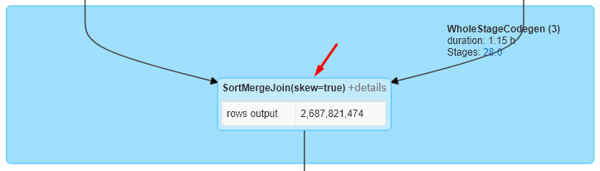
The 5 Most Common Performance Problems (The 5 Ss)
Skew Mitigation Roundup
Step | Code | Duration | Tasks | Health | Shuffle | Spill
C | Baseline | ~30 min | 832 | Bad | 0 / 0 / ~100 KB / ~400 MB / ~3 GB | ~50 GB
D | Skew Hint | ~35 min | 832 | Mostly OK | ~135 MB / ~175 MB / ~180 MB / ~200 MB / ~1 GB | ~4 GB
E | w/AQE | ~25 min | 1489 | Excellent | 0 / ~115 MB / ~115 MB / ~125 MB / ~130 MB | 0
F | Salted | ~37 min | 832 | OK | ~400K / ~70 MB / ~150 MB / ~290 MB / ~790 MB | 0
See Experiment #1596, Step C, Step D, Step E, and Step F
Especially the SQL diagram for Step E showing skew=true
Notes:
We go into AQE and this specific optimization later

Slide 25
Optimizing Apache Spark
The Five Most Common Performance
Problems - Condensed
Spill

Slide 26

The 5 Most Common Performance Problems (The 5 Ss)
Spill
Spill is the term used to refer to the act of moving an RDD from RAM to disk, and later back into RAM again
This occurs when a given partition is simply too large to fit into RAM
In this case, Spark is forced into [potentially] expensive disk reads and writes to free up local RAM
All of this just to avoid the dreaded OOM Error
Possibly the most significant contributor to poorly performing Spark jobs

Slide 27
The 5 Most Common Performance Problems (The 5 Ss)
Spill - Examples
There are a number of ways to induce this problem:
Mismanagement of spark.sql.shuffle.partitions (default is 200)
The explode() of even a small array
The join(), or worse, crossJoin() of two tables
Aggregating results by a skewed feature

Slide 28
The 5 Most Common Performance Problems (The 5 Ss)
Spill - Memory & Disk
In the Spark UI, spill is represented by two values:
Spill (Memory): For the partition that was spilled, this is the size of that data as it existed in memory
Spill (Disk): Likewise, for the partition that was spilled, this is the size of the data as it existed on disk
The two values are always presented together
The size on disk will always be smaller due to the natural compression gained in the act of serializing that data before writing it to disk

Slide 29

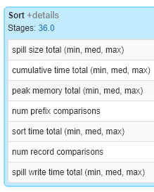

The 5 Most Common Performance Problems (The 5 Ss)
Spill - In the Spark UI
A couple of notes:
Spill is shown on the Stage Details page under:
Summary Metrics
Aggregated Metrics by Executor
The Tasks table
Or in the corresponding query details
Hard to recognize because one has to hunt for it
When no spill is present, the corresponding columns don’t even appear in the Spark UI - that means if the column is there, there is spill somewhere

Slide 30
The 5 Most Common Performance Problems (The 5 Ss)
Spill Listener To The Rescue!
See Experiment #6518, Step A-2
The SpillListener is taken from Apache Spark’s test framework
The SpillListener is a type of SparkListener and tracks when a stage spills
Useful to identify spill in a job when you are not looking for it
We can see example usage in Step B through Step E
While written in Scala, Databricks ability to mix Scala and Python in a single notebook means anyone can employ this little tool
Notes:
As a straight read, each partition should be hitting 128 MB each, Spark’s default behavior.
Because we haven’t done anything to alter this (explode, aggregate, tweak ingest) it should not have any spill

Slide 31
The 5 Most Common Performance Problems (The 5 Ss)
Spill - Examples, Review
Step | Min | 25th | Median | 75th | Max | Total
B - shuffle | ~2 GB / ~550 MB | ~2 GB / ~560 MB | ~2 GB / ~565 MB | ~2 GB / ~570 MB | ~2 GB / ~580 MB | ~33 GB
C - union | ~2 GB / ~110 MB | ~2 GB / ~120 MB | ~2 GB / ~125 MB | ~2 GB / ~130 MB | ~2 GB / ~150 MB | ~60 GB
D - explode | 0 / ~1.5 GB | 0 / ~1.5 GB | 0 / ~1.5 GB | 0 / ~1.5 GB | 0 / ~1.5 GB | ~750 GB
E - join* | 0 / 0 | 0 / 0 | 0 / 0 | 0 / 0 | 6 GB / 3 GB | ~50 GB
See Experiment #6518
In Step B, the config value spark.sql.shuffle.partitions is not managed
Steps C & D simply grow too large as a result of their transformations
In Step E the spill is a manifestation of the underlying skew

Slide 32
The 5 Most Common Performance Problems (The 5 Ss)
Spill - Mitigation
The quick answer: allocate a cluster with more memory per worker
In the case of skew, address that root cause first
Decrease the size of each partition by increasing the number of partitions
By managing spark.sql.shuffle.partitions
By explicitly repartitioning
By setting spark.sql.files.maxPartitionBytes lower than the default 128MB
Not an effective strategy against skew
Ignore it - consider the example in Step E.
Out of ~800 tasks only ~50 tasks spilled
Is that 6% worth your time?
Notes:
More memory is the easiest answer here.
Not all spill problems are a result of skew - the explode() operation is a solid example of this
But if skew is the root cause, that should be addressed first - addressing skew may negate the need to address spill
Changing partition size in light of skew shouldn’t help - each partition is the size it is because of the skew - more partitions in this case only means more zero-byte partitions

Slide 33
Optimizing Apache Spark
The Five Most Common Performance
Problems - Condensed
Shuffles

Slide 34
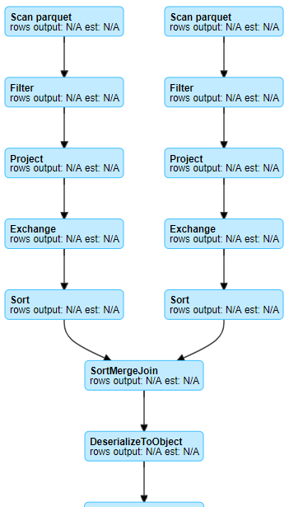
The 5 Most Common Performance Problems (The 5 Ss)
Shuffle
Shuffling is a side effect of wide transformation:
join()
distinct()
groupBy()
orderBy()
And technically some actions, e.g. count()

Slide 35
The 5 Most Common Performance Problems (The 5 Ss)
Shuffles At A Glance

Slide 36
The 5 Most Common Performance Problems (The 5 Ss)
Shuffle - Being Pragmatic
Don’t get hung up on trying to remove every shuffle
Shuffles are often a necessary evil
Focus on the [more] expensive operations instead
Many shuffle operations are actually quite fast
Targeting skew, spill, tiny files, etc often yield better payoffs
Coming
Soon...

Slide 37
The 5 Most Common Performance Problems (The 5 Ss)
Shuffle - Mitigation
Reduce network IO by using fewer and larger workers
Use NVMe & SSDs so that the shuffle reads and writes are faster
Reduce the amount of data being shuffled
Remove any unnecessary columns
Preemptively filter out unnecessary records
Denormalize the datasets - especially when the shuffle is rooted in a join
Reevaluate your join strategy - the default is not always the best
Notes:
By using fewer and larger VMs (e.g. more cores), we still pay the cost for disk io, but reduce network io
AQE & DPP should be making it unnecissary to denormalize datasets as Spark moves forward. But it is a viable strategy outside of Spark 3

Slide 38
The 5 Most Common Performance Problems (The 5 Ss)
Optimizing Joins
We have a number of different options we can explore here:
Reordering the join
Bucketing
Broadcast Hash Join
Shuffle Hash Joins (default for Databricks Photon)
Sort-Merge Join (default for OS Spark)

Slide 39
The 5 Most Common Performance Problems (The 5 Ss)
Mostly
Automatic w/AQE & CBO
Optimizing Joins - Reordering
If we join three tables, it logically makes more sense to order the joins such that we reduce the number of records involved in each shuffle
Table A
w/1 trillion
records
Table B
w/1 billion
records
Table AB
w/1 trillion
records
Table C
w/1 million
records
Table ABC
w/1 thousand
records
outer
inner
Full Shuffle of A & B
Broadcast C
Table A
w/1 trillion
records
Table C
w/1 million
records
Table AC
w/1 thousand
records
Table B
w/1 billion
records
Table ABC
w/1 thousand
records
inner
outer
Broadcast C
Broadcast AC
Notes:
Scenario A:
If we join Table A and Table B, we shuffle the full recordset and do not reduce the number of records giving us Table AB
Then we Table AB to Table C but Table C can be broadcasted and the result of the join is Table ABC with only 1K records
Scenario B:
If we join Table A and Table C, we get the immediate benefit of the broadcast, but we also reduce the number of records to 1K in Table AC
Because Table AC is only 1K records, it can be broadcasted as it’s joined to Table B.
90% automatic because you might want to help AQE & CBO by capturing statistics for join keys and filtered columns

Slide 40
The 5 Most Common Performance Problems (The 5 Ss)
Optimizing Joins - Bucketing
“If you are bucketing datasets, you are doing it wrong” - DT
Bucketing is hard to get right and is an expensive operation to being with… ...especially if you are bucketing a periodically changing dataset
Eliminates the sort in the Sort-Merge Join by pre-sorting partitions
The cost is paid in production of the dataset on the assumption that savings will be made by frequent joins of both tables
Not worth considering for datasets less than 1-5 terabytes
Notes:
DT = Daniel Tomes, from one of his presentations are Spark Summit

Slide 41
The 5 Most Common Performance Problems (The 5 Ss)
Optimizing Joins - Broadcast Hash Join
Minimize the shuffle operation by sending the broadcasted table to each executor resulting in an executor-local join w/o the expense of SMJ or HJ
By default, applied to tables under 10 MB
AQE & CBO together can detect when a predicate pushes a dataset below the prescribed threshold
See spark.sql.autoBroadcastJoinThreshold and spark.databricks.adaptive.autoBroadcastJoinThreshold

Slide 42
The 5 Most Common Performance Problems (The 5 Ss)
Optimizing Joins - Broadcast Hash Join
BHJ put extra pressure on the Driver, possibly resulting in OOM Errors
All fragments of the table are collected in the driver from each executor
After the table is reassembled, it is redistributed to each of the executors
For small tables, this overhead is significantly lower than a SMJ or HJ
It’s not uncommon to broadcast tables as large as 1GB (vs the 10MB default)
There is no magic formula for this, you just have to experiment with it
Make sure that the Driver and Executors are capable of possessing the table

Slide 43
The 5 Most Common Performance Problems (The 5 Ss)
Sort-Merge Join (SMJ) vs Hash Join (HJ)
When we cannot employ a BHJ, we default to a SMJ. Why?
Because SMJs, while comparatively slow, scale REALLY well
In most cases SMJs are also slower than HJ so why default to SMJ?
It takes less time to create the hash than it does to execute the sort
Both scenarios still shuffle the data
But, HJs requires the data to fit into memory == potential OOM Errors
Compared to SMJs which are, for the most part, OOM-Proof
But wait! With Databricks Photon, the default is to use the HJ
See spark.sql.join.preferSortMergeJoin

